Slide 2
Programming Is Fun!
http://www.csit.upei.ca/itap_portal/
Notes:
This is an example Power Point presentation. When making your own, remember to use pictures! Pictures will help you remember what to say better than words on a slide, and they will keep the judges more interested. A nice balance of pictures and words will bring success.

Slide 3
What is Programming?
Set of instructions
Composed of commands and functions
Used to solve a specific problem
Not the same thing as coding
Notes:
Programming is a process that solves a problem by writing a plan (program) using a series of commands and functions to be executed.

Slide 4
Why Do We Program?
Keep with the times
Stimulates the brain
It is fun!
Notes:
Computers have become a big part of our day-to-day activities. Certainly, you do not need to know how to program to survive, but with the rapid development of electronics, it helps to know how to program!

Slide 5
How Do You Learn To Program?
Research software
Download or use online software
Start programming!
http://mcrcoderdojo.org.uk/coding-for-kids-ipads-iphones-ipods-part-1/
https://en.wikipedia.org/wiki/Scratch_%28programming_language%29
Notes:
There are so many ways to learn how to program. Today, schools and companies release tons of free learning programs. An example is M.I.T.’s release of Scratch and Scratch Jr.

Slide 6
Lets Program!
Scratch is a Visual Programming Language (VPL)
Great to learn with
Best way to learn is practice

Slide 7
What Are Commands?
Commands perform a specific task.
http://speak-it.com/what-are-natural-language-commands/
Notes:
It is how we tell the computer what to do in the program.
When you press the power button on a computer, you are sending a command to the computer telling it to turn “on” or “off”.

Slide 8
What are Functions?
Functions are a collection of commands.
Functions make programs more efficient.
https://www.ykode.com/2015/01/25/thinking-functional-software.html
Notes:
For example, instead of adding 2 to itself until I reach 10, I can use a command called a “loop” and have it continue to add by 2 until it reach 10. Using multiple commands like this is what makes a function.

Slide 9
Commands and Functions In Scratch

Slide 10
Commands and Functions Cont.
Commands and functions make up a program.
A program can be simple or complex.
http://technogstic.blogspot.com/2014/03/scratch-jr-kickstarter-aims-to-teach.html
Notes:
A program can be as simple as making this cat move to the right on the screen, or as difficult as making the cat play hopscotch with the chicken

Slide 11
Some Scratch Commands
Move – moves a sprite along the X or Y axis
Hide – Makes a sprite invisible
Show – Makes a sprite visible
Wait – Makes the program pause for a specified time
Switch – Switches costumes and backgrounds

Slide 12
Programming in action!
Interactive adventure story
ocean based
Uses Event controls to manipulate scenarios
https://scratch.mit.edu/projects/100088852/

Slide 13
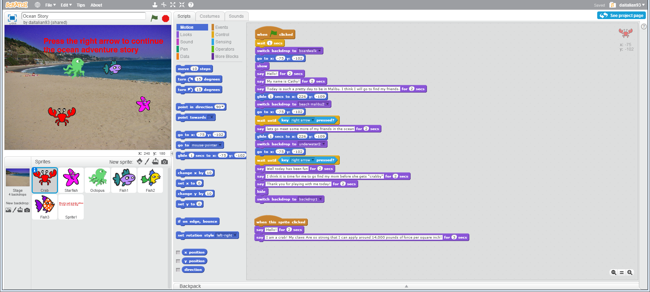
Ocean Adventure

Slide 14
Ocean Creature’s code

Slide 15
Conclusion
Programming can be fun!
http://www.clker.com/clipart-238147.html
Notes:
In conclusion, programming can be fun! You just have to have the right attitude and willingness to learn.

Slide 16
Sources
Wikipedia
Scratch.org
Scratchjr.org
Google Images

Slide 17
Questions?

